Slide 1
Arts and Humanities Faculty Research and Creative Inquiry Showcase and Reception
The Faculty Research and Creative Inquiry Showcase celebrates recipients of Arts and Humanities Course Release and Large Grants and features the results of their work through lightning talks and visual displays

Slide 2
Ashley Hope Pérez | Comparative Studies
Sustaining Care in Advocacy for Readers’ Rights
My A&H course release supported:
The completion of Banned Together: Our Fight for Readers’ Rights, an anthology of banned authors writing about the need to protect access to literature.
A full grant proposal submission to the Mellon Foundation for a Unite to Read Project that seeks to support engagement with banned literature and sustainable advocacy for readers’ rights. The grant would accomplish this by creating a series of cumulative events, and institute, and a summit to support participants in planning and enacting their own advocacy efforts.
Establishing a set of practices to center care in advocacy, to build a focus on health, belonging, presence, curiosity, connection, creativity, and playfulness. These supports are especially important to those confronting environments turned toxic by right-wing agitation.
The United to Read Project has just been awarded a $500,000 grant from the Mellon Foundation!

Slide 3


Literary Trash: The Art of Modern Hebrew Entertainment Fiction
Naomi Brenner,
Near Eastern & South Asian Languages and Cultures
Reading novels designed to entertain and to sell, this book analyzes key texts that constituted a Hebrew literary culture for the masses, exploring the aesthetics and politics that undergird modern entertainment fiction.

Slide 4


Lake Baikal: The Great Lake and its People
Dr. Nicholas Breyfogle
History
An environmental history of the world’s oldest and largest lake

Slide 5
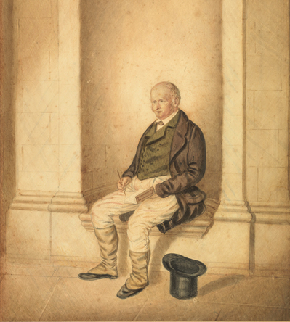
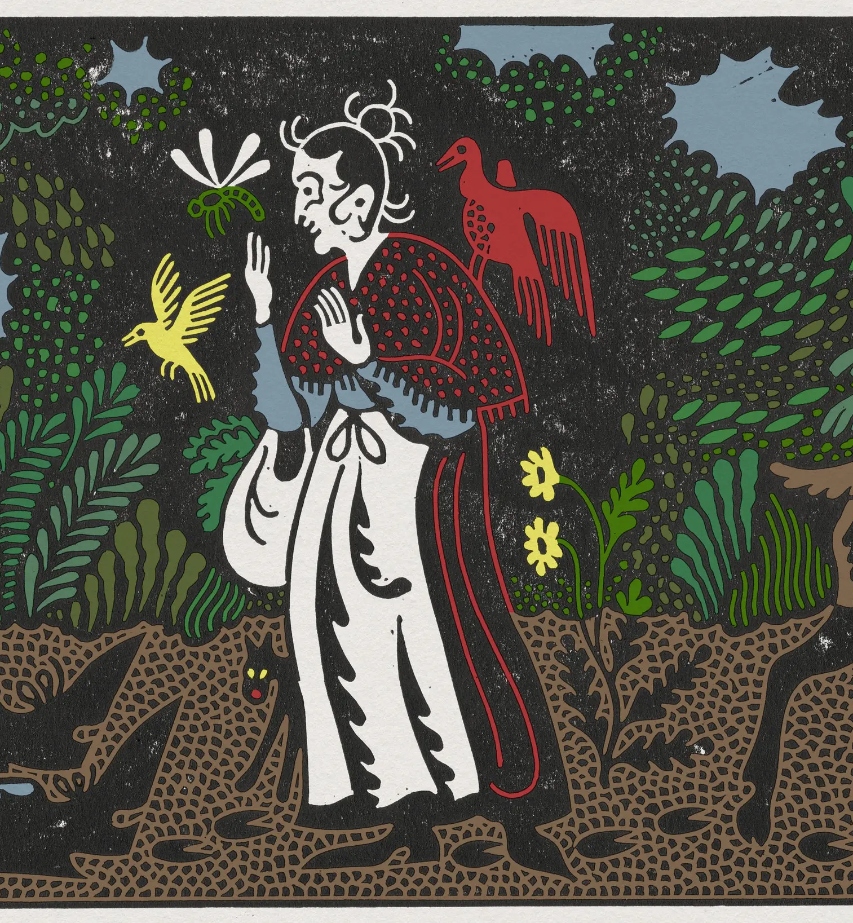
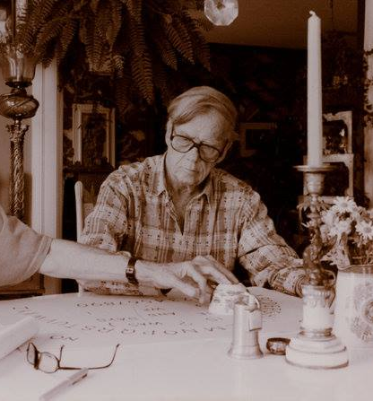
Hail Muse, Et Cetera
On Influence, Originality, and the Ends of Literature
Jake Risinger
Department of English

Slide 6
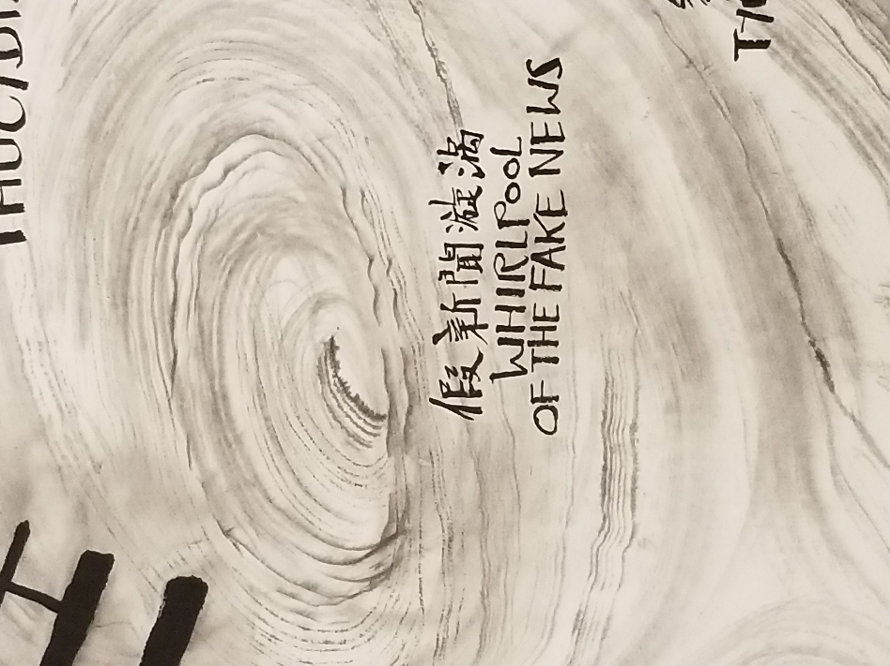
Push and Pull: The Textual Forces of Three Kingdoms Era Political Prose, ca. 190–280
Meow Hui Goh, East Asian Languages and Literatures
How did texts exert push and pull forces in the aftermath of the fall of the Han empire? How did texts act as bodies to impact other bodies in this context?

Slide 7
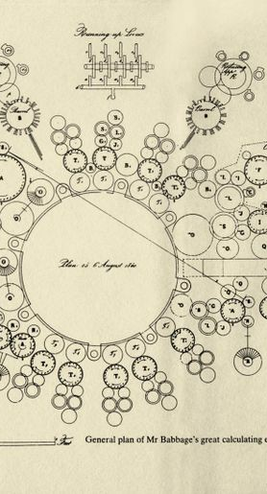
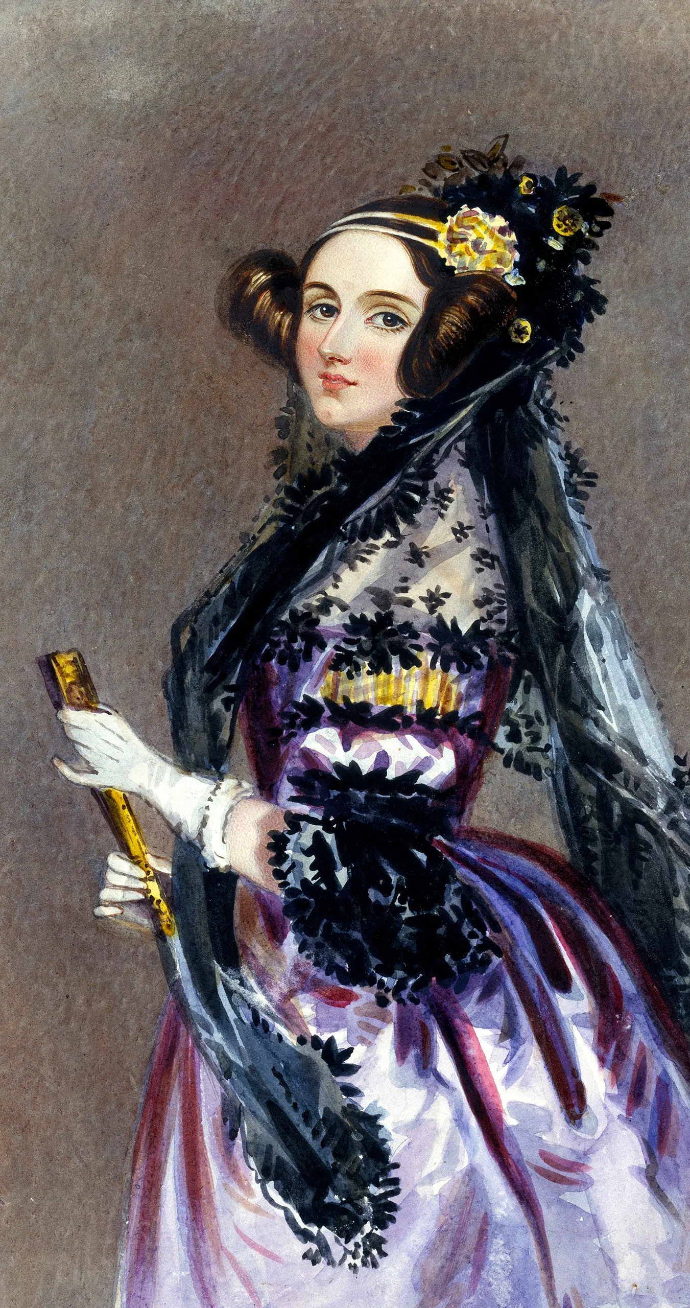
Jamison Kantor, Associate Professor, English Department
The Romance of Automation: Romanticism and Automatic Matter, 1750-1850
This is an intellectual history of early automation by way of the literature, art, and philosophy of the industrial revolution. Through an analysis of that culture, I connect the idea of “automatic matter” to emerging paradigms of historical inevitability: the Whig view of history, the liberal “end of history,” dialectical materialism, and more.
Figures in the project include: Phillis Wheatley Peters, Francis Williams, John Constable, William Wordsworth, G.W.F. Hegel, Friedrich Koenig, John Keats, Mary Shelley, Percy Shelley, William Makepeace Thackeray, Ada Lovelace, Karl Marx, Frances Harper, and others.

Slide 8
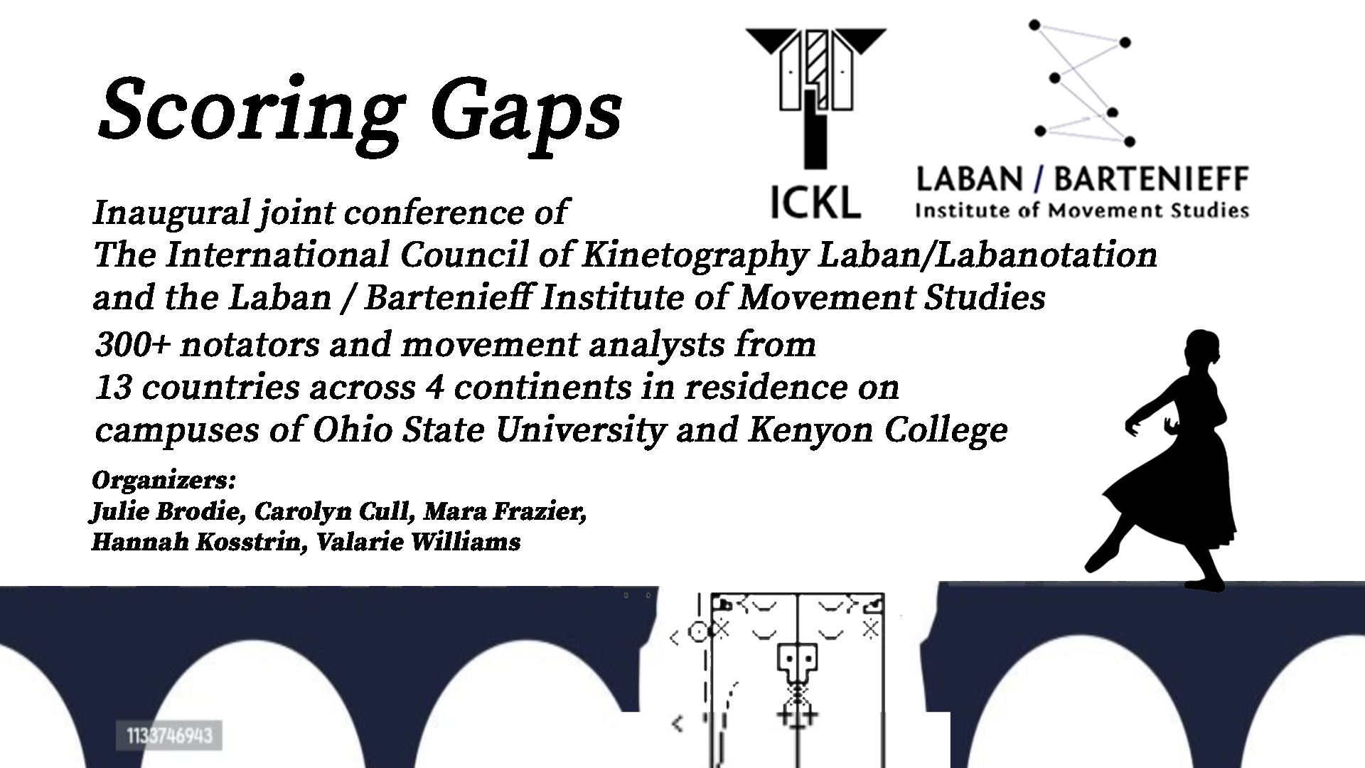

Slide 9
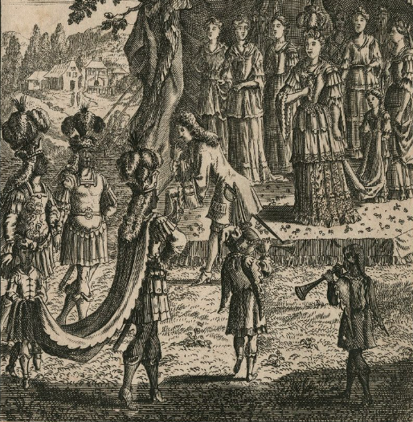
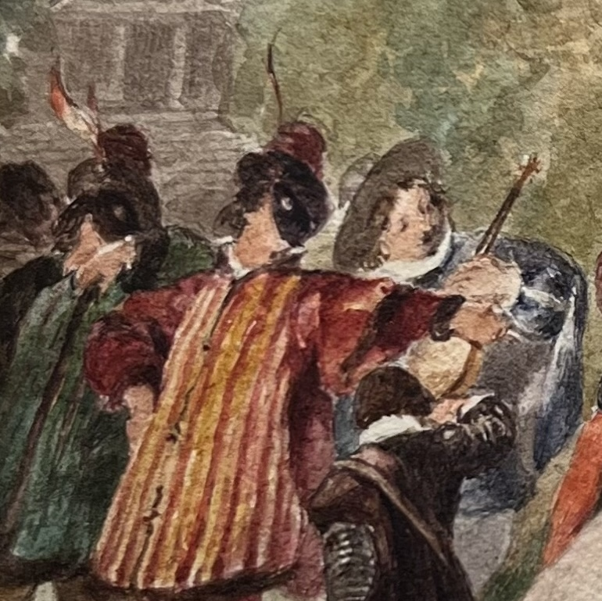
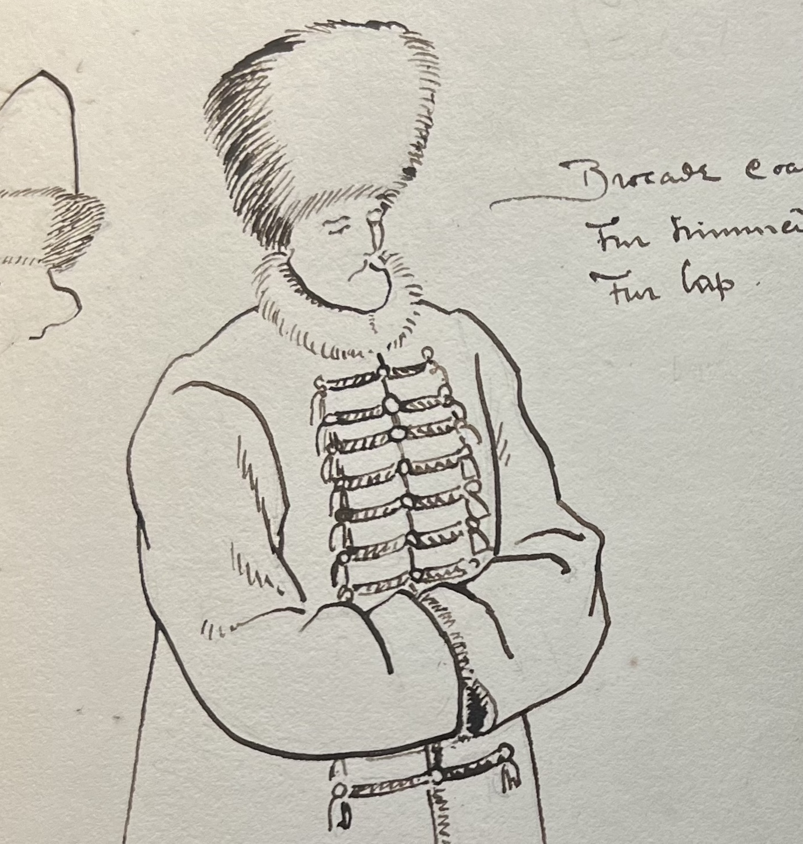
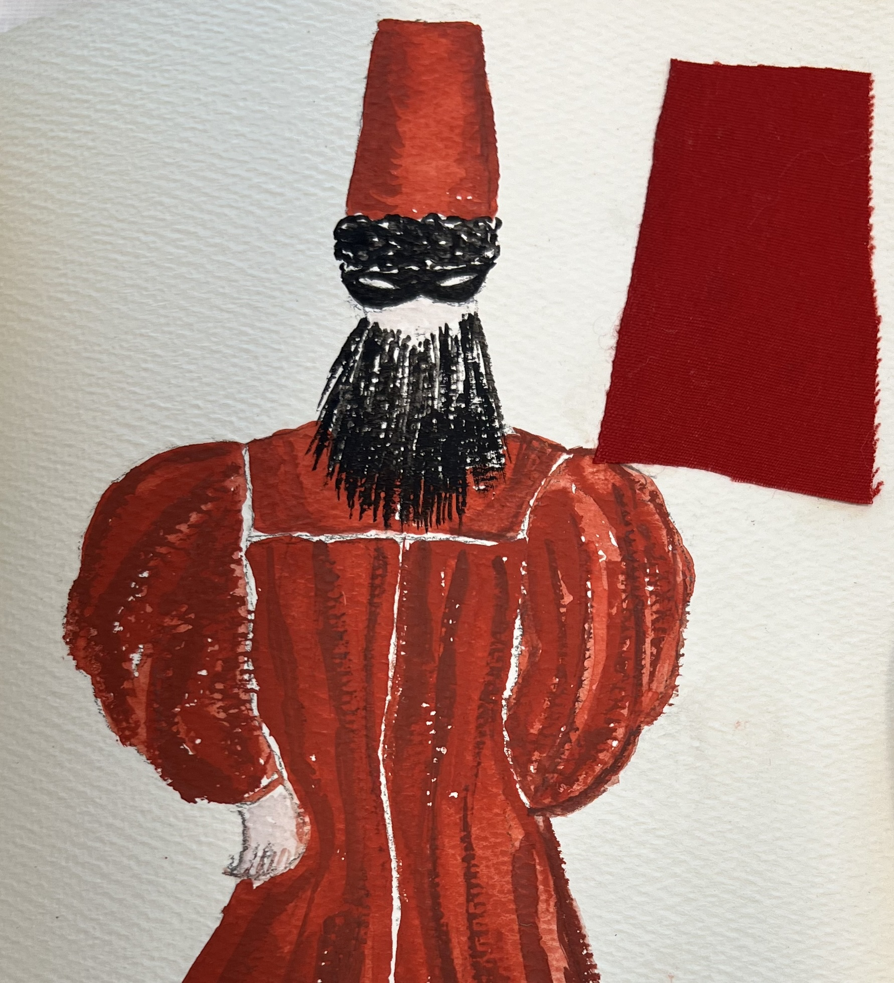
Performing Identity in Shakespeare’s Masques
Elizabeth Kolkovich
Department of English

Slide 10
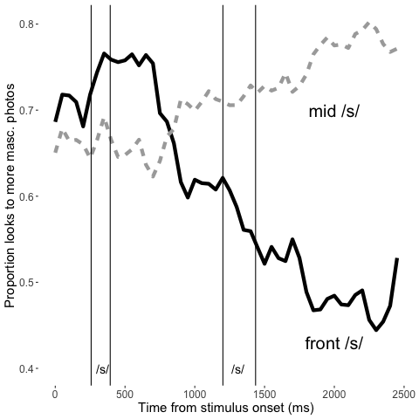
Kathryn Campbell-Kibler
Department of Linguistics
Eye tracking for sociolinguistic impression
We adapted the visual world paradigm to capture social impressions, instead of language comprehension. Here, a fronted /s/ (the “gay lisp”) prompts participants to look at less masculine faces after about a second

Slide 11
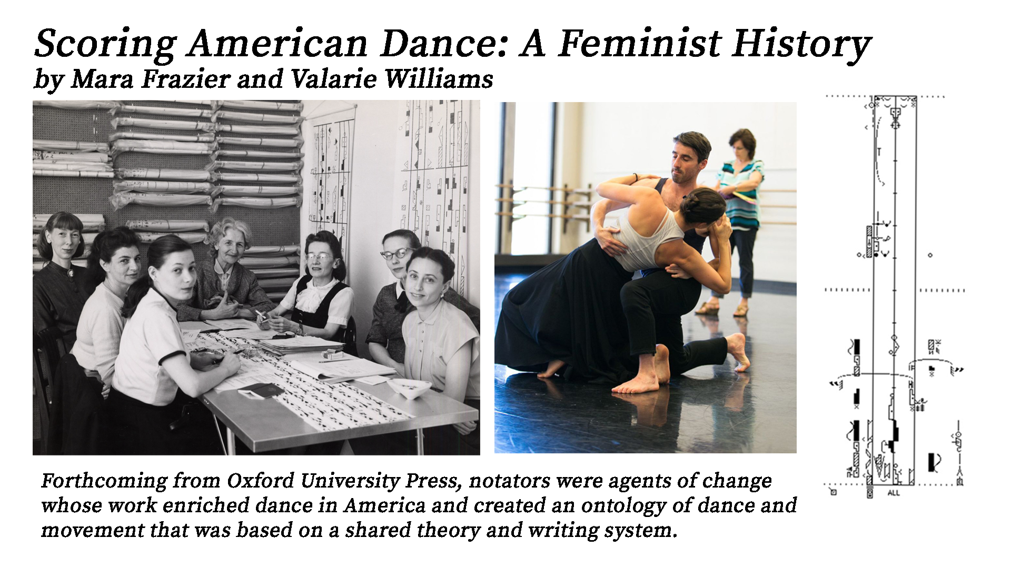

Slide 12


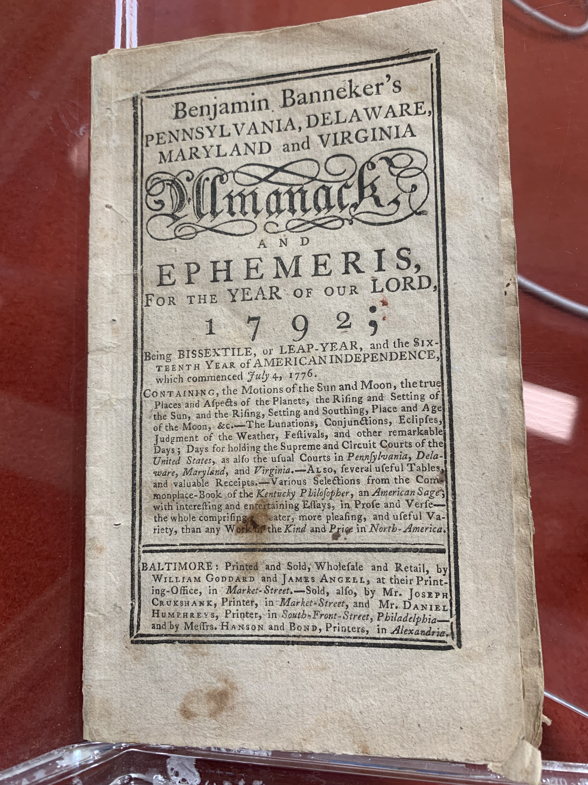
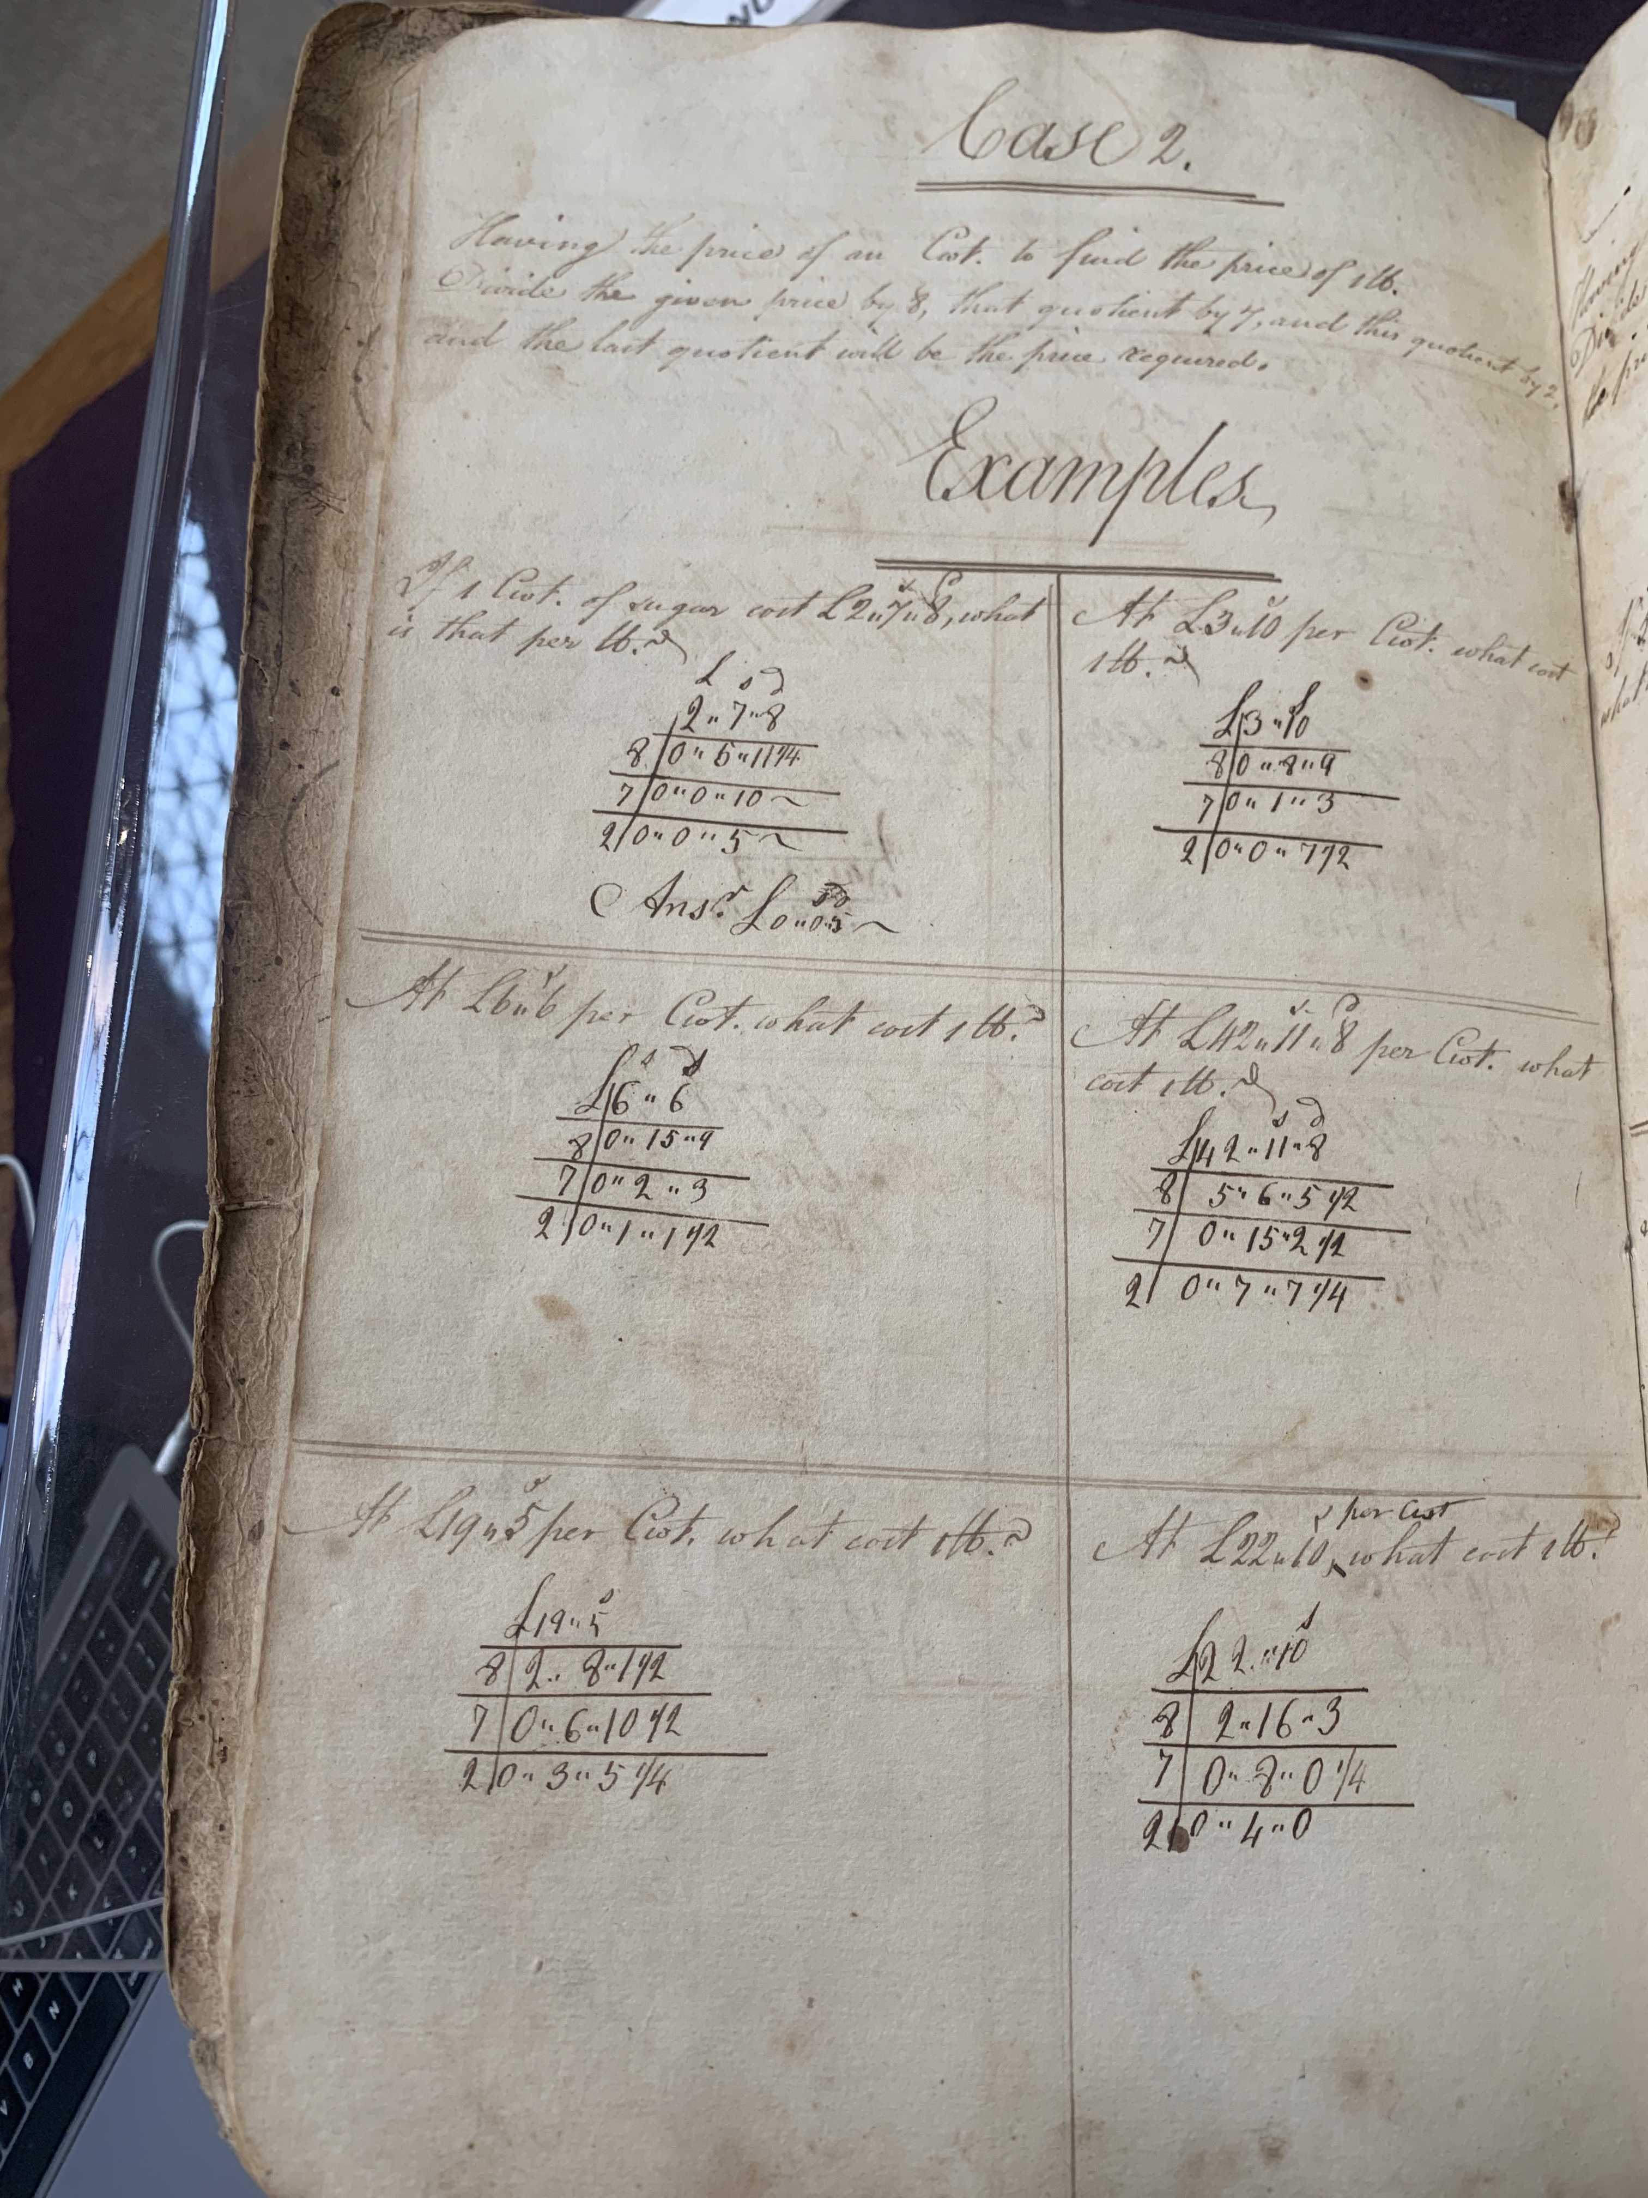
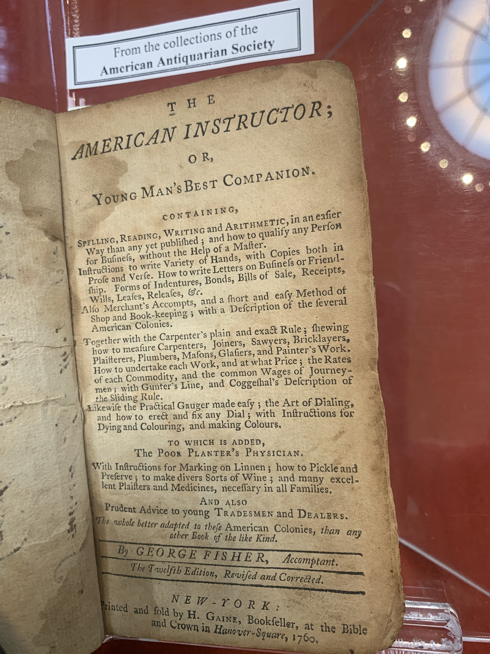
Molly Farrell
New World Calculation: The Making of Numbers in Colonial America (Forthcoming from Stanford University Press)
[Photo\Graphic]
[Photo\Graphic]
[Photo\Graphic]
What if math is a form of humanist inquiry?
How did colonialism shape what a number is and can do?
What if we looked at numeracy the way literacy studies understands reading?

Slide 14
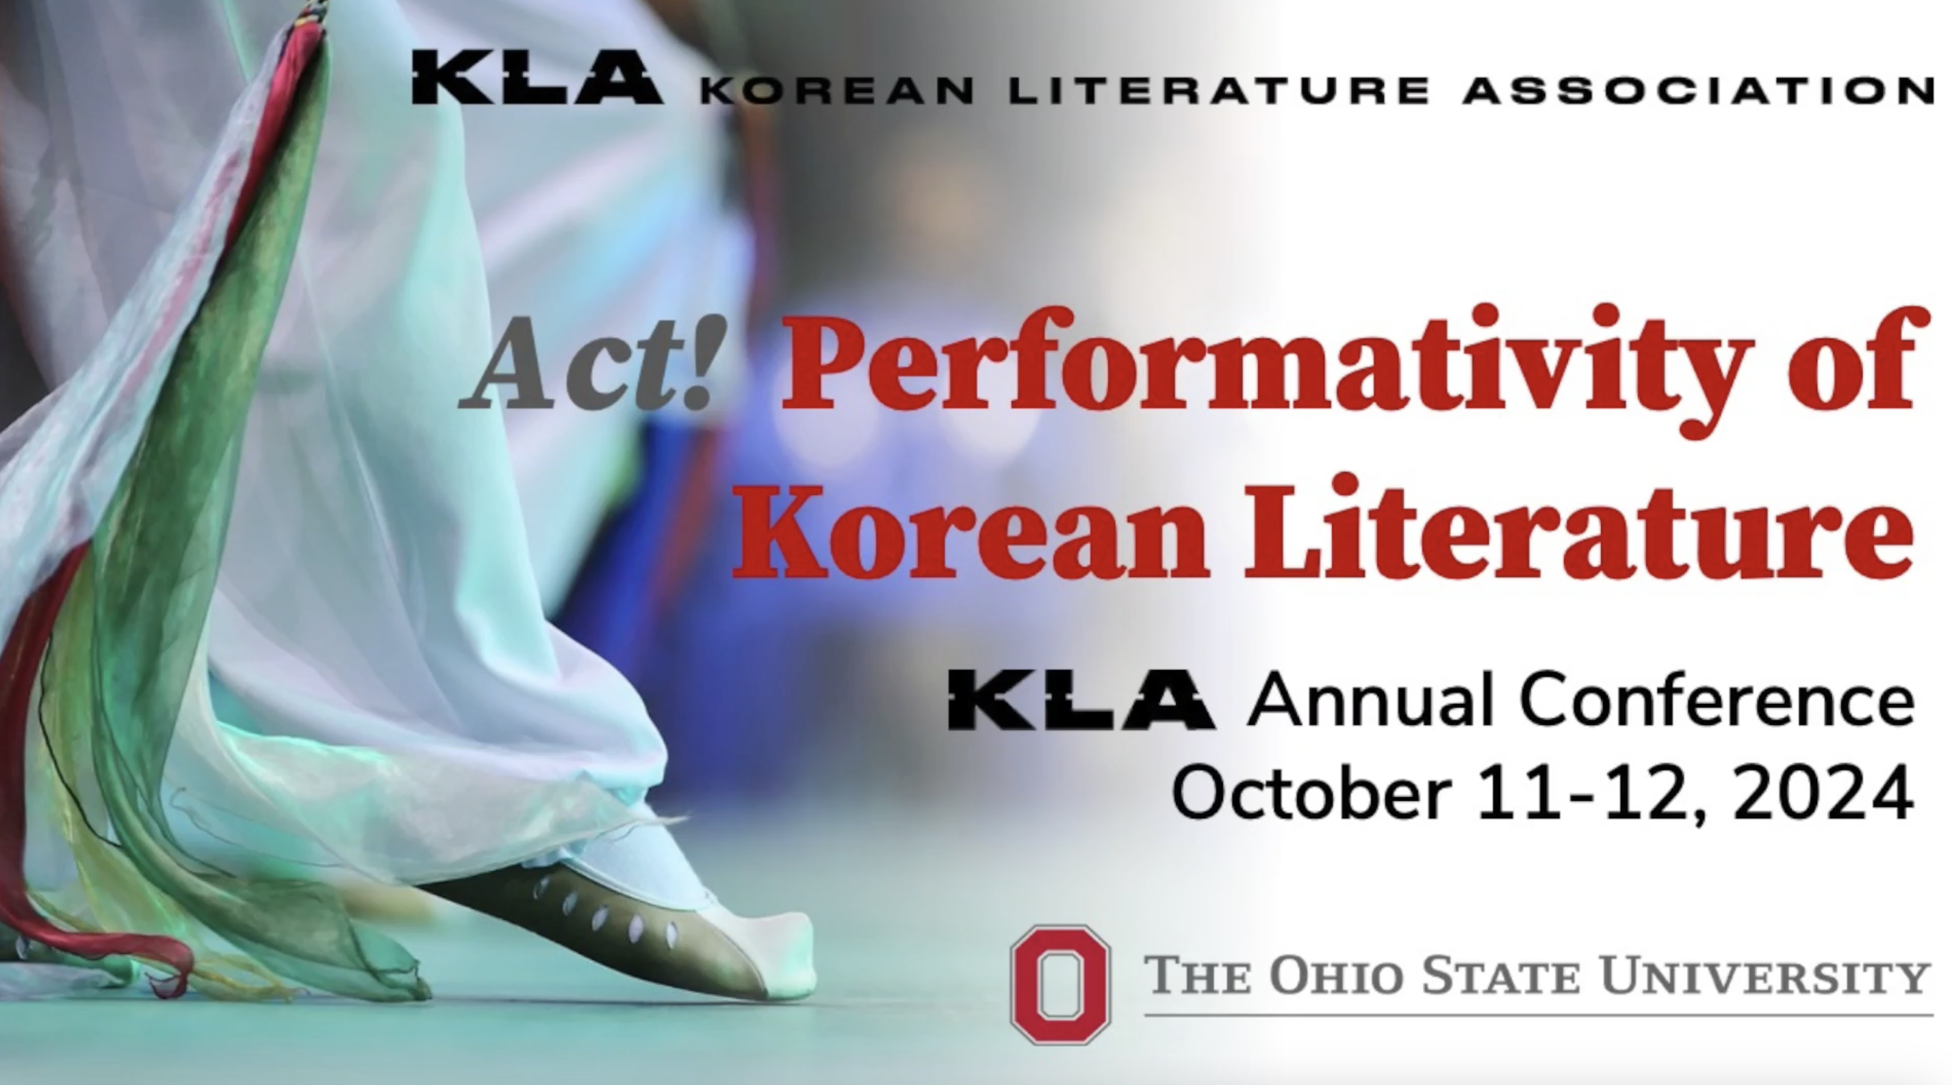
Pil Ho Kim, Associate Professor
East Asian Languages and Literatures

Slide 15
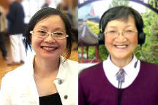

STUDY #1: French and American Accents:
Does Speaker Accent Impact L2 Vocabulary Learning?
  BACKGROUND: Teaching of pronunciation has shifted from an emphasis on nativeness or accent elimination to a focus on intelligibility and comprehensibility. The native speaker standard, however, remains prevalent in foreign language instruction, where native speakers are still often viewed as better instructors.
  STUDY: A lexical input processing framework is used to investigate whether American L2 French students show differences in lexical learning when hearing target words spoken by French vs. American speakers.
  RESULTS & IMPLICATIONS: Data from an immediate and delayed cued picture production task and a translation task reveal no statistical differences for voice. This suggests that novel French words are not learned better when spoken by French speakers rather than by American speakers.
  This study challenges the belief that native speakers are “better” speakers for teaching a foreign language.
Wynne Wong (Principal Investigator), Dept. of French & Italian & Marjorie K.M. Chan (Co-Investigator), DEALL
Arts and Humanities Faculty Research and Creative Inquiry Showcase. 2 December 2024
Arts & Humanities Large Grant (Sp 2023)
The Effects of Acoustic Variability on Lexical Input Processing:
Accents and Regional Varieties (Three Languages: French ٠ English ٠ Chinese)
College of Arts and Sciences
Arts & Humanities Division

